Slide 1
STOCK MARKET ANALYSIS
DATA SCIENCE AND MACHINE LEARNING CAPSTONE
MADE BY –
SAYAK BHOWICK (11703368)
LAKSHYA AGARWAL (11703425)

Slide 2
FRONT END

Slide 3
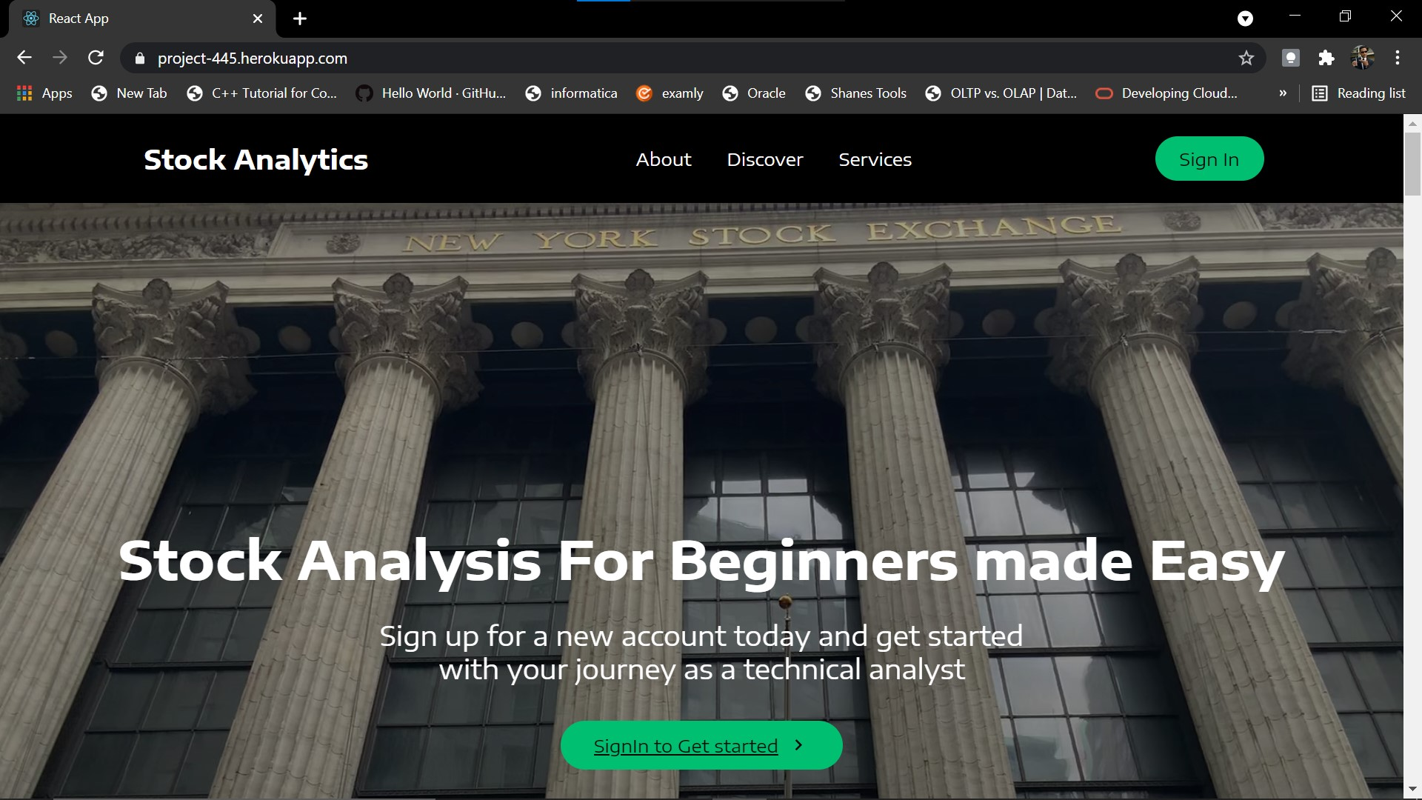
HOME WEBPAGE

Slide 4
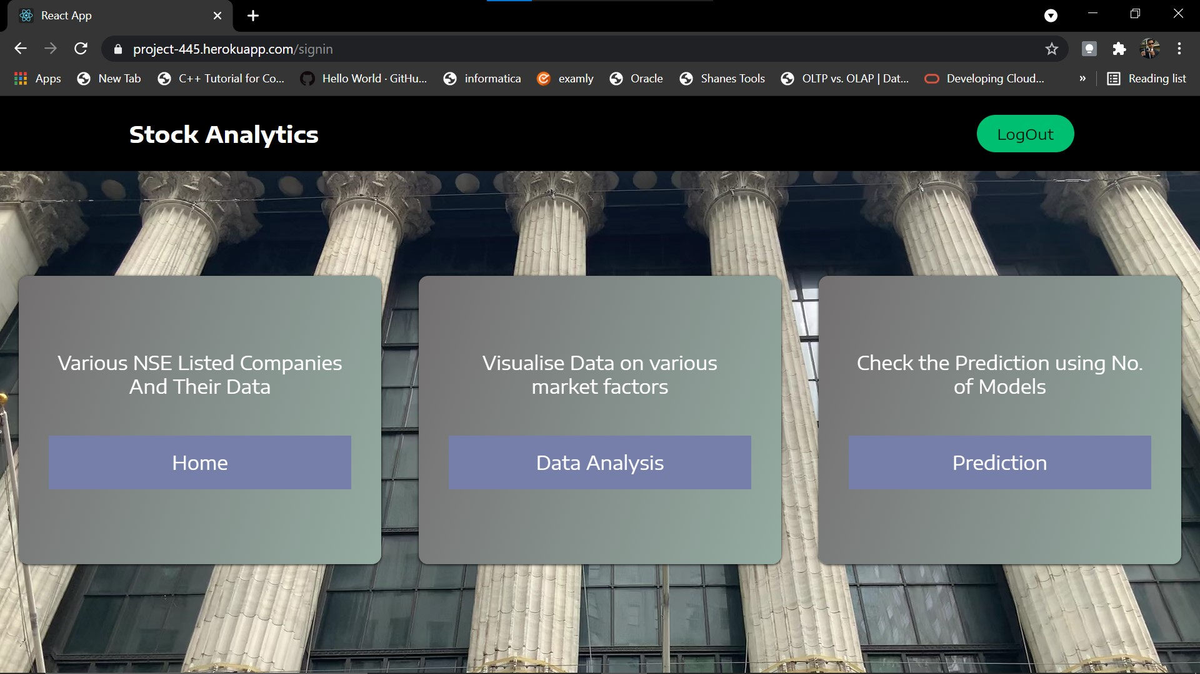
MODULES

Slide 5
USER AUTHENTICATION

Slide 6
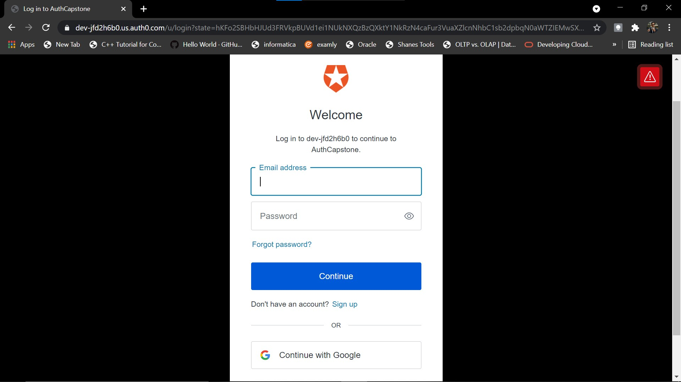
SIGN IN PAGE

Slide 7
HOME PAGE

Slide 8
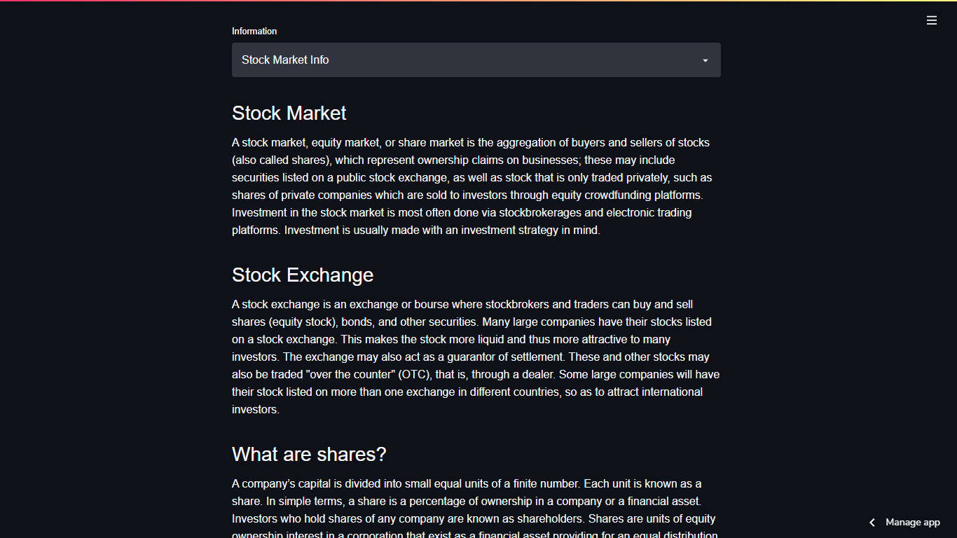
STOCK MARKET INFORMATION

Slide 9
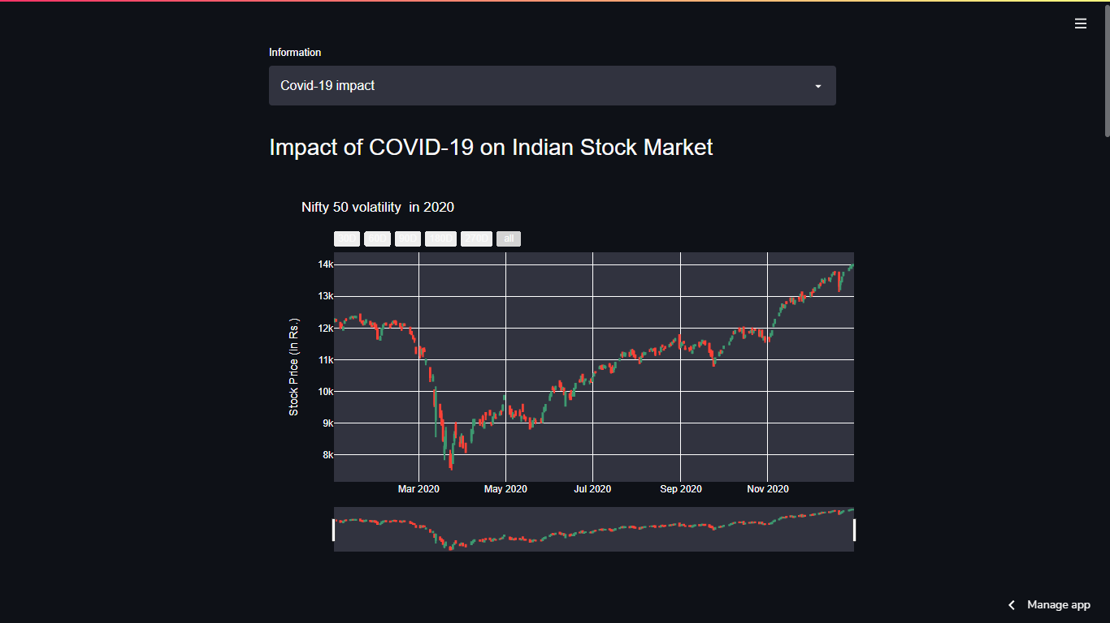
COVID-19 IMPACT ON MARKET

Slide 10
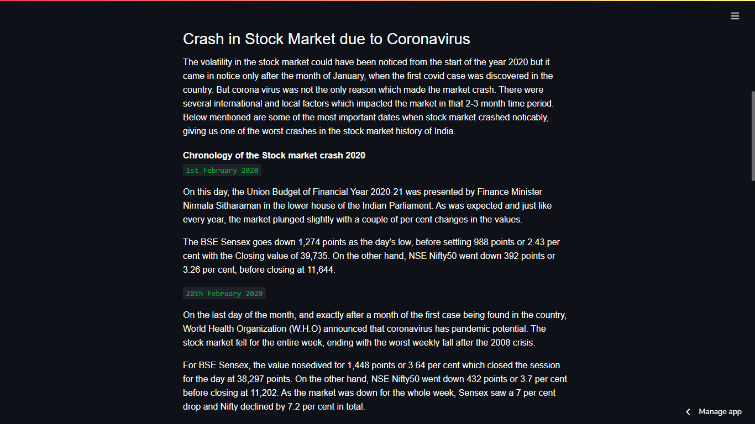
COVID-19 IMPACT ON MARKET

Slide 11
DATA ANALYSIS

Slide 12
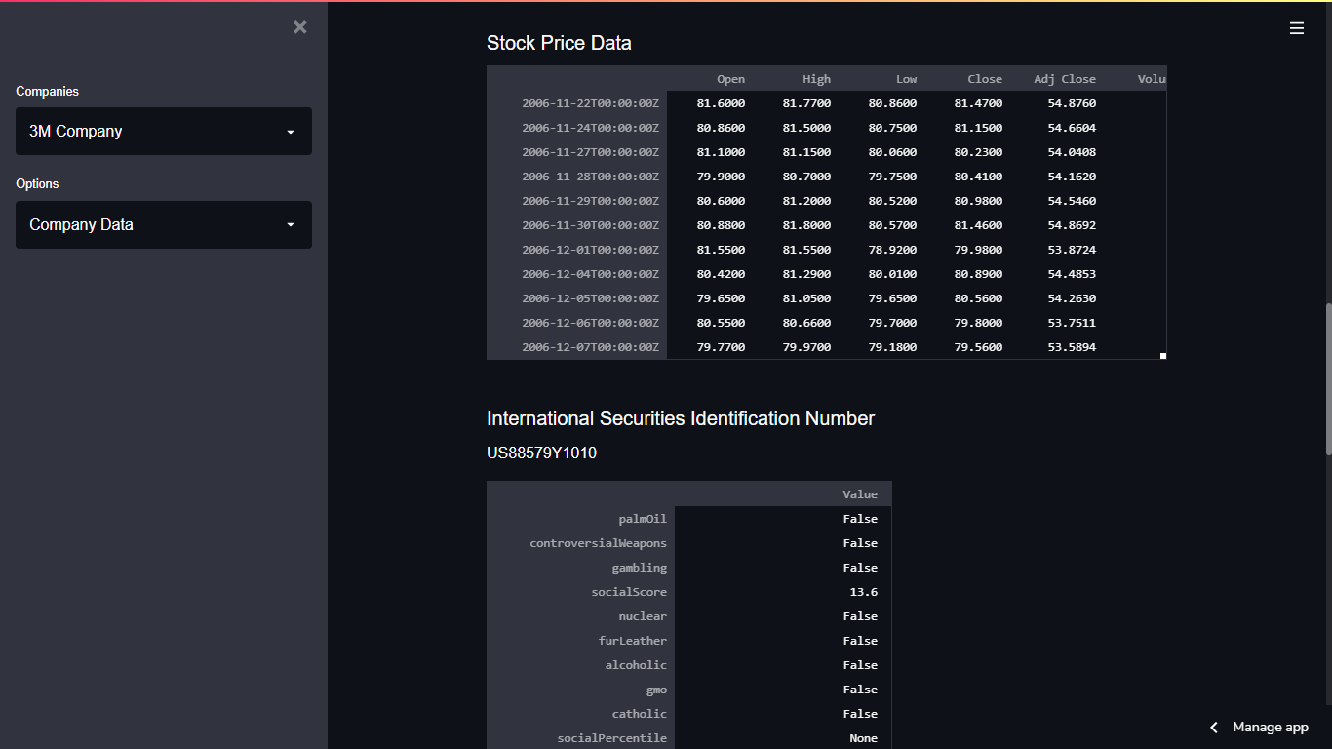
COMPANY INFORMATION

Slide 13
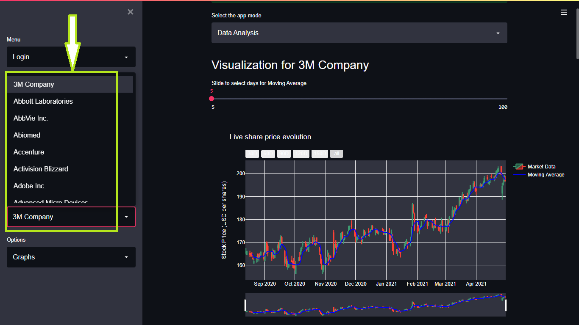
VISUALIZATION OF STOCK DATA

Slide 14
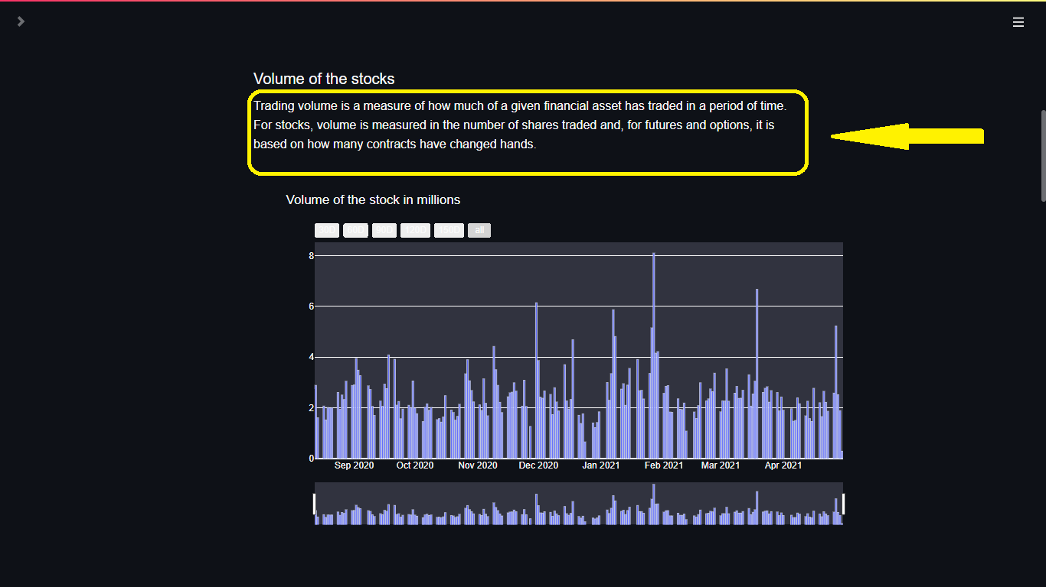
VISUALIZATION OF STOCK DATA

Slide 15
PREDICTIONS

Slide 16
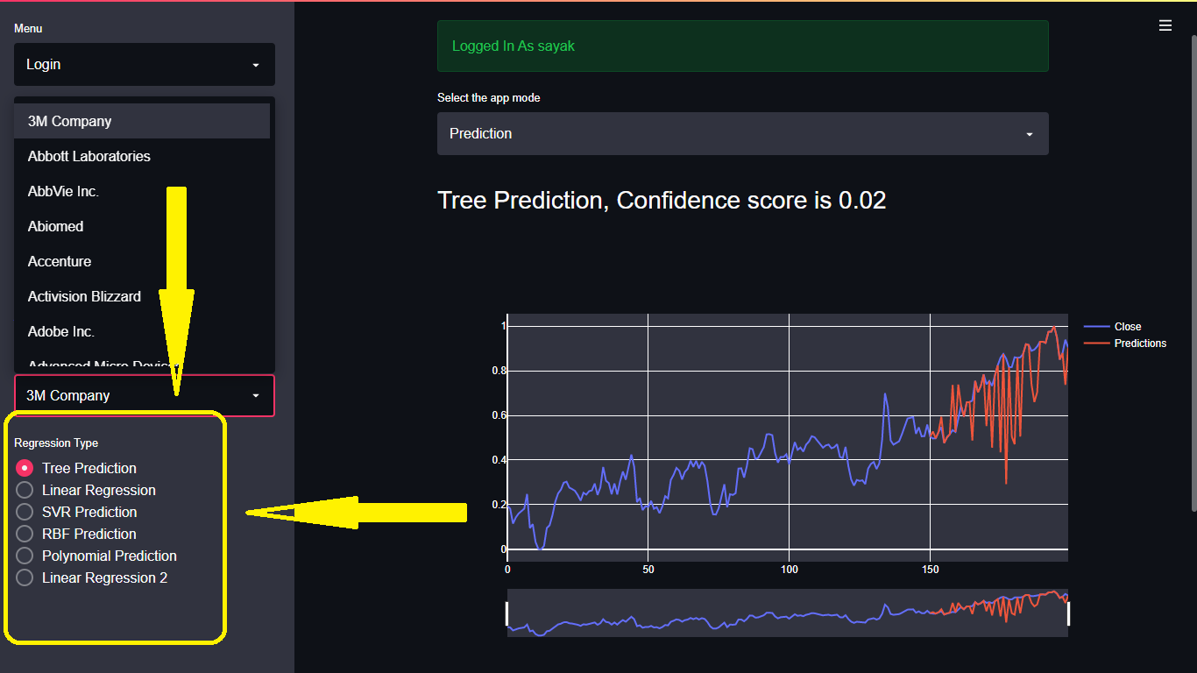
TREE PREDICTION GRAPH

Slide 17
TECHNOLOGIES USED
FRONT END DESIGNING –
React JS
USER AUTHENTICATION –
Auth0 3rd party authentication platform
BACKEND DESIGNING –
Python
Streamlit
Github

Slide 18
HOSTING PLATFORMS
Heroku Hosting Platform by Salesforce
Streamlit Share

Slide 19
REFERENCES
http://share.streamlit.io/
http://www.heroku.com/
http://github.com/

